Slide 1


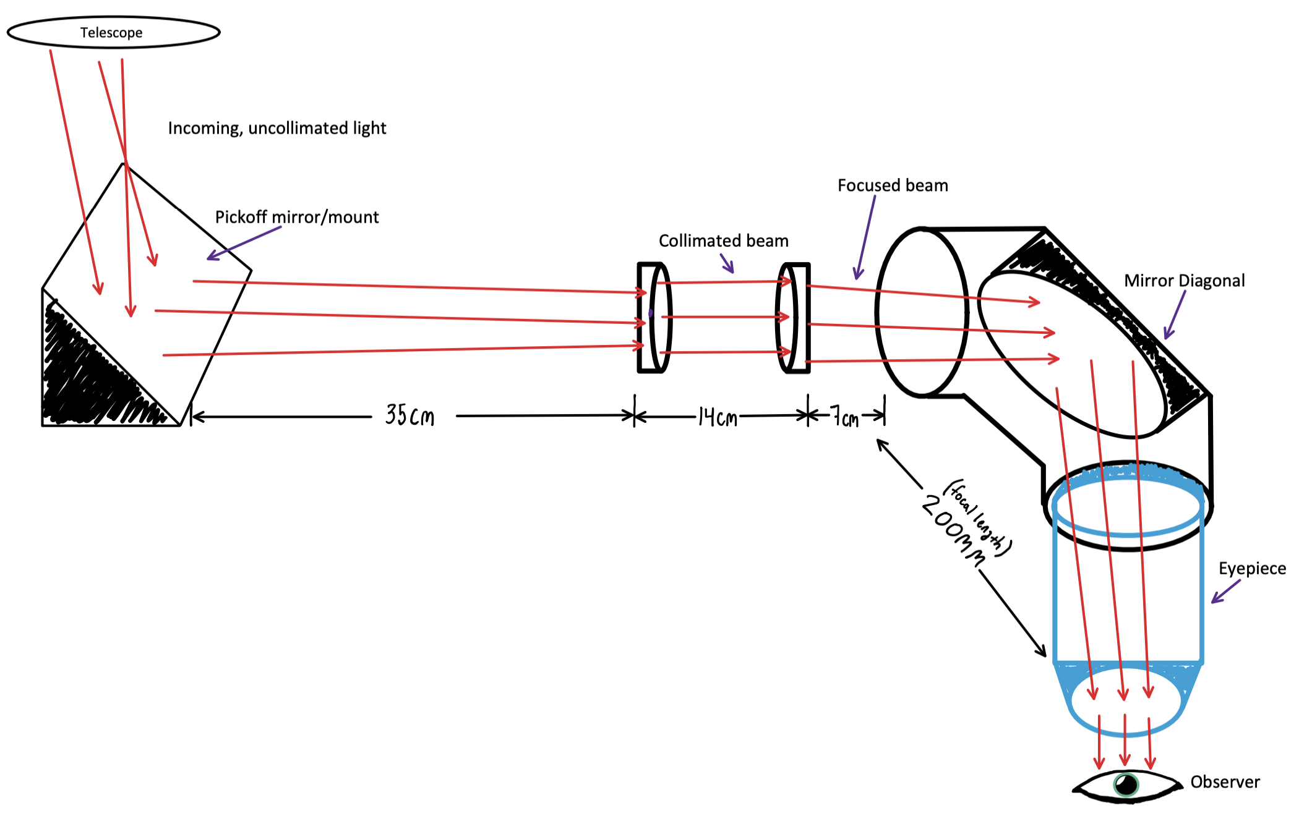
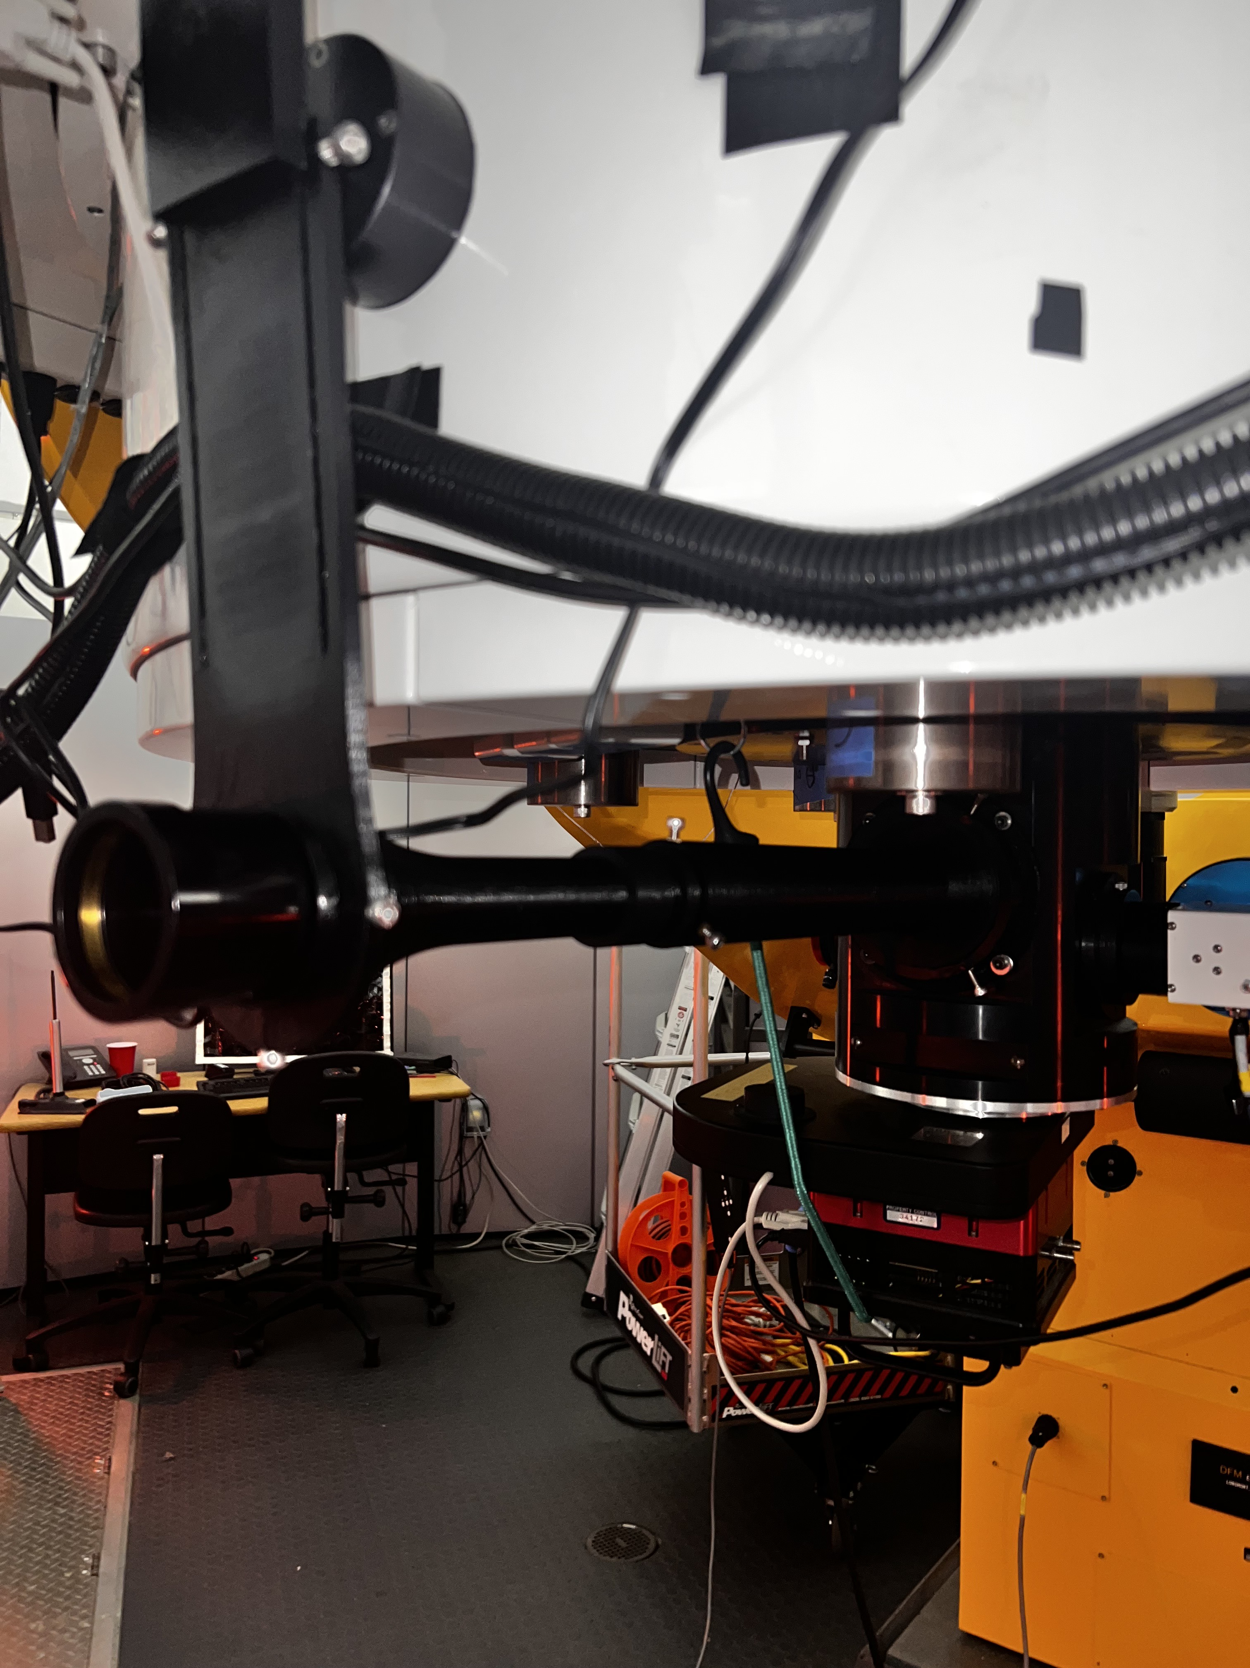
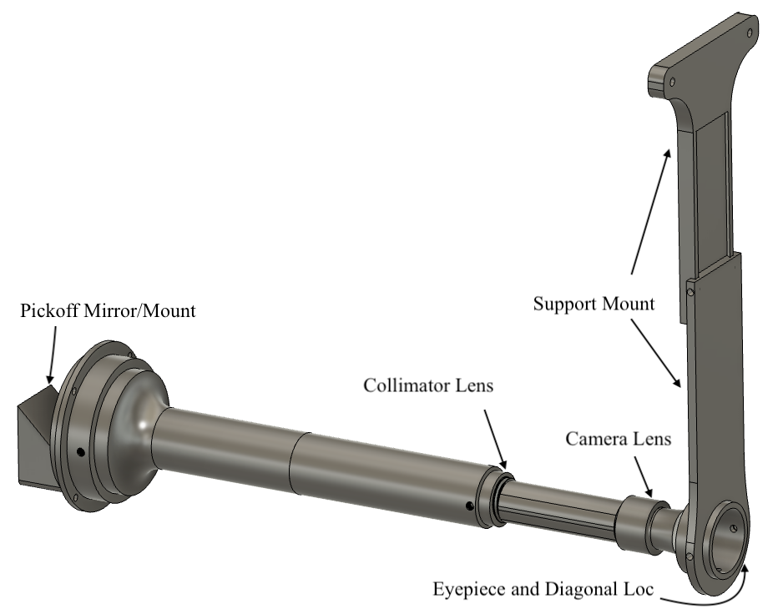
A 3D Printed Outreach Periscope for the Embry-Riddle Aeronautical University 1-meter Telescope
Principle Investigator: Jacob R. Romeo
Research Advisor: Dr. Vikas Sudesh
ABSTRACT
BACKGROUND
The Embry-Riddle Aeronautical University (ERAU) observatory is equipped with a 1-meter f/8 Ritchey-Chretien telescope. The faculty conducts public Astronomy open houses, featuring night-sky viewing through the 1-meter six times a year. The previous method to view the night sky was to use an eyepiece in the output port on the underside of the 1-meter mirror holder. This put the sensitive equipment and observers in risk of damage due to the large mirror cell. The Outreach Periscope obviates the need to dismount the instrument package to install an eyepiece, considerably improving access to it (Fig. 3).
The Outreach Periscope allows guests to observe the night sky with the 1-meter. The housings for the mirror and lenses and the extended tubes were designed and 3D-printed (Fig. 1) in the Engineering Physics Propulsion Lab. The Periscope consists of a 50.8 mm x 50.8 mm flat fold mirror and two identical, 30 mm diameter achromatic doublet lenses. These relay the focal plane to an eyepiece at an easily accessible location outside the main bulk of the telescope (Fig. 2). The first run with the Periscope was on September 27, 2023, was a success.
Figure 2. A simple ray diagram of the optical setup, showing the plane mirror, achromatic doublet lenses, mirror diagonal, eyepiece, and observer, left to right.
METHODS
The final version was printed and assembled into the periscope using PLA filament.
The threaded inserts allow the observer to make small adjustments to the focus.
The support for the system, shown in Fig. 1, is bolted to the side of the mirror cell.
The pieces were printed individually, allowing for shorter print times, reducing malfunction, allowing for accurate prints, and maximum upgradeability.
Figure 1. CAD model of the Periscope, labeling important components.
FUTURE WORK
An extension needs to be made to give ease for observations when the telescope is high on the horizon.
The pickoff mount occludes the research camera, solving this by directing the incoming light to both objects using a Wollaston Prism to polarize the beam.
Figure 3. The Outreach Periscope mounted into the port on the underside of the mirror cell on the 1-meter.

